Slide 1
Lesson 1: Connecting networks
Computing systems and networks – The internet
Notes:
Last updated 28-07-21
Resources are updated regularly — the latest version is available at: ncce.io/tcc.
This resource is licensed under the Open Government Licence, version 3. For more information on this licence, see ncce.io/ogl.

Slide 2
Lesson 1: Connecting networks
Objectives
To describe how networks physically connect to other networks
I can describe the internet as a network of networks
I can demonstrate how information is shared across the internet
I can discuss why a network needs protecting

Slide 3
What is the internet?
Introduction
How would you describe the internet?
Write your answer in your worksheet?
Notes:
Sticky note image: https://pixabay.com/illustrations/post-it-yellow-shadow-2010489/

Slide 4
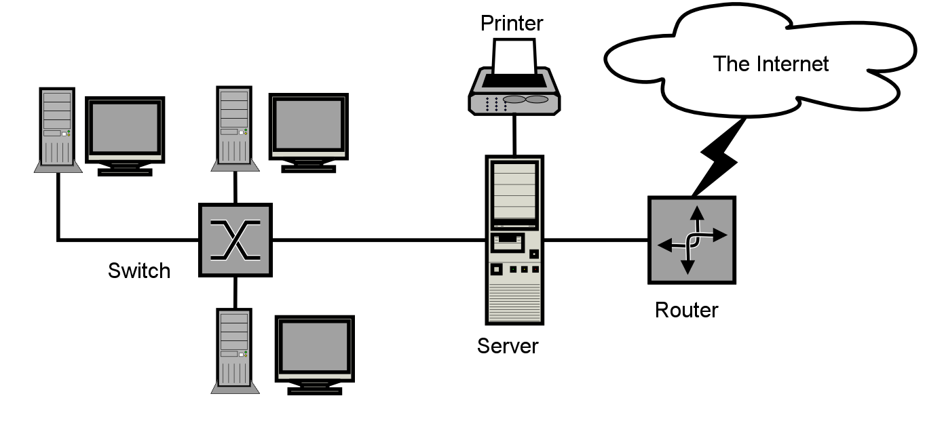
A computer network
Activity 1
Connecting computers
2
3
4
Desktop computers
Connecting people
1
5
Wires
Network switch

Slide 5
What is a network?
Lets have a look….
https://www.bbc.co.uk/teach/class-clips-video/computing-ks2-computer-networks/zf67wnb

Slide 6
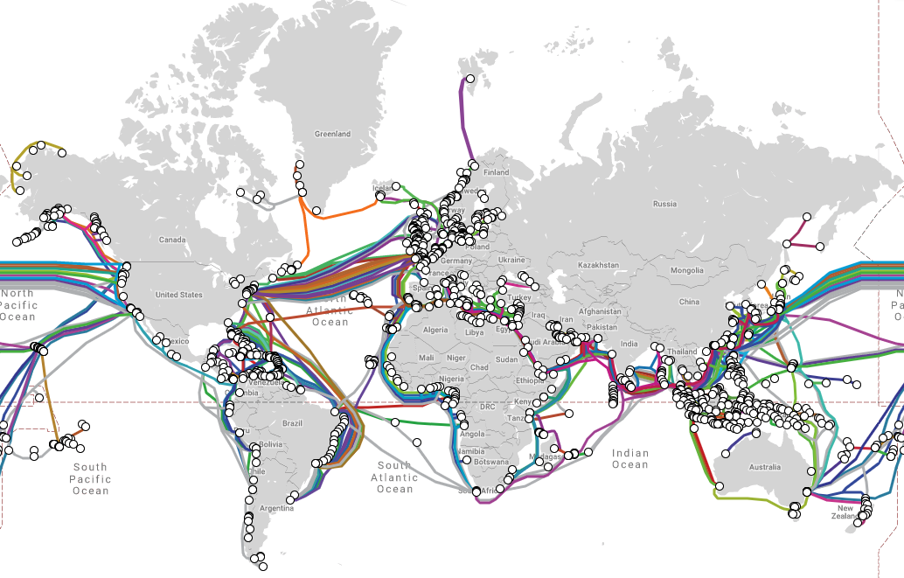
The internet – a global network of networks
Activity 2
Why are there so many cables?
submarinecablemap.com

Slide 7
Why do we need to keep networks safe?
Activity 3
You wouldn’t allow everyone into your home.
It is important not to let everyone on to your network.
Keeping a network safe is the same as making sure you lock your front door.
Think, pair, share — what could happen if anyone could access your network?
Notes:
Door image: https://pixabay.com/vectors/door-entrance-front-door-entry-575968/

Slide 8
Task: Create your own network.
Here's what the images mean….
Printer
Computer
The Internet
Server

Slide 9
Securing networks
Activity 3
Networks have security features to block or allow messages or requests.
Desktop computers
2
3
4
1
5
Wires
Router
Network switch

Slide 10
What is the internet?
Plenary
How would you describe the internet?
Think, pair, share your ideas with the rest of your group.
Notes:
Sticky note image: https://pixabay.com/illustrations/post-it-yellow-shadow-2010489/

