Slide 1
Year 4 – Spring Block 2 – Speech – Punctuating Direct Speech
About This Resource:
This PowerPoint has been designed to support your teaching of this small step. It includes a starter activity and an example of each question from the Varied Fluency and Application and Reasoning resources also provided in this pack. You can choose to work through all examples provided or a selection of them depending on the needs of your class.
National Curriculum Objectives:
English Year 4: (4G5.7) Using and punctuating direct speech
English Year 4: (4G5.7) Use of inverted commas and other punctuation to indicate direct speech [for example, a comma after the reporting clause; end punctuation within inverted commas: The conductor shouted, “Sit down!”]
More resources from our Grammar, Punctuation and Spelling scheme of work.
Did you like this resource? Don’t forget to review it on our website.
© Classroom Secrets Limited 2019

Slide 2
Year 4 – Spring Block 2 – Speech – Punctuating Direct Speech
Notes and Guidance:
From the previous step, children should know that direct speech is opened and closed with inverted commas, and that a comma should be used after a reporting clause, for example: The police officer yelled, “Stop, thief!”
In this step, children will learn to punctuate direct speech.
Children should know that the first spoken word begins with a capital letter and that punctuation is required before the closing inverted commas. The punctuation mark is dependent on the words being spoken and the manner in which they are said.
Examples of speech with different punctuation marks include: The football fans shouted, “Come on you blues!”; Isla asked, “Can I borrow a pencil please?”
Focused Questions
Has this direct speech been punctuated correctly?
Add the correct punctuation into this sentence to show direct speech.
© Classroom Secrets Limited 2019

Slide 3
Year 4 – Spring Block 2 – Speech
Step 2: Punctuating Direct Speech
© Classroom Secrets Limited 2019

Slide 4
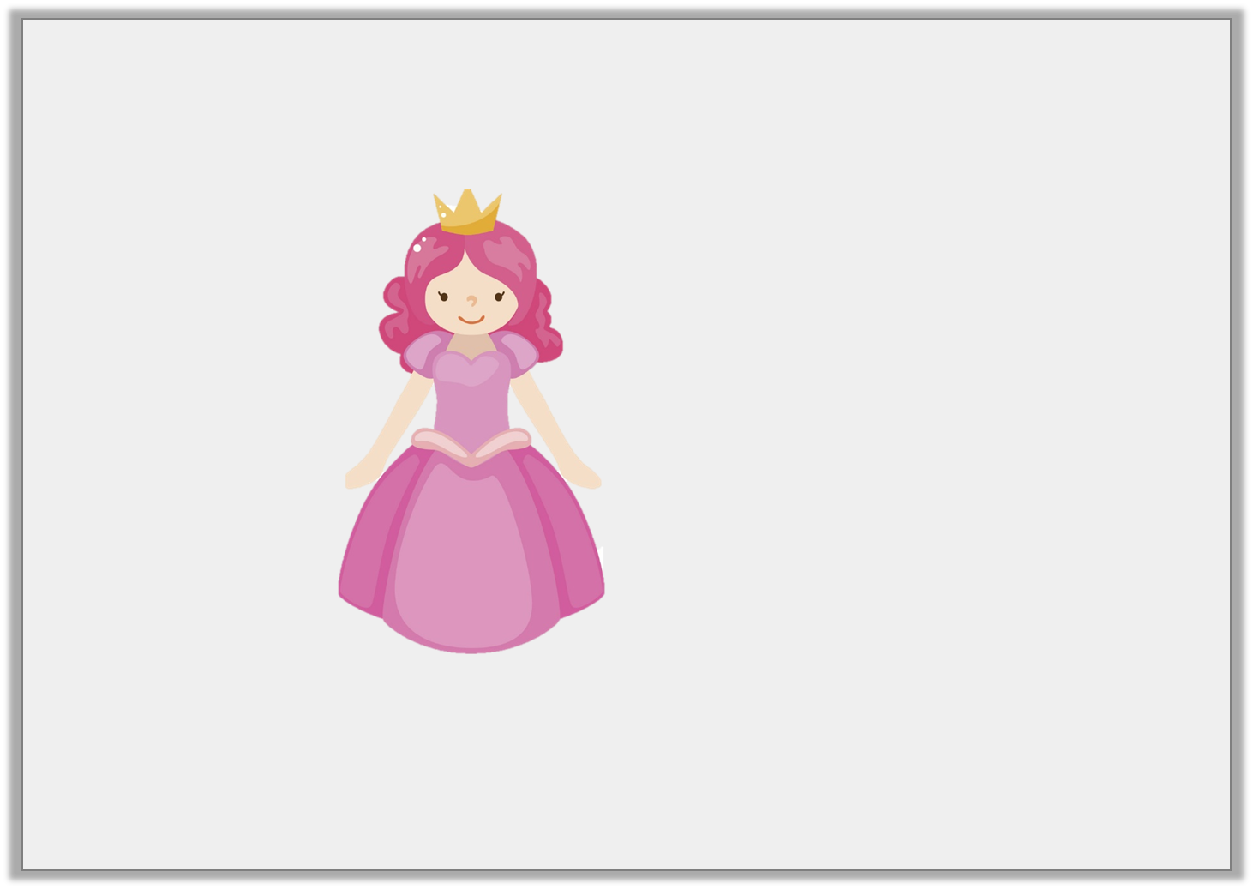
Introduction
Which words should be in the speech bubble?
Cinderella exclaimed, “Now I can go to the ball!”
© Classroom Secrets Limited 2019

Slide 5
Introduction
Which words should be in the speech bubble?
Now I can go to the ball!
Cinderella exclaimed, “Now I can go to the ball!”
© Classroom Secrets Limited 2019

Slide 6
Varied Fluency 1
Circle the missing or incorrect punctuation in this sentence:
“ Mother said, Don’t talk to any strangers!”
© Classroom Secrets Limited 2019

Slide 7
Varied Fluency 1
Circle the missing or incorrect punctuation in this sentence:
“ Mother said, Don’t talk to any strangers!”
Mother said, “Don’t talk to any strangers!”
© Classroom Secrets Limited 2019

Slide 8
Varied Fluency 2
Tick the sentence that has been punctuated correctly.
The wolf asked, “where are you going little girl?”
Little Red Riding Hood replied, “I am going to visit my grandmother.”
© Classroom Secrets Limited 2019

Slide 9
Varied Fluency 2
Tick the sentence that has been punctuated correctly.
The wolf asked, “where are you going little girl?”
Little Red Riding Hood replied, “I am going to visit my grandmother.” |  | ✓
© Classroom Secrets Limited 2019

Slide 10
Varied Fluency 3
Tick where the inverted commas should go.
Dear Grandmother, what big ears you have!
exclaimed Little Red Riding Hood.
© Classroom Secrets Limited 2019

Slide 11
Varied Fluency 3
Tick where the inverted commas should go.
✓
✓
Dear Grandmother, what big ears you have!
exclaimed Little Red Riding Hood.
© Classroom Secrets Limited 2019

Slide 12
Varied Fluency 4
Punctuate these sentences:
little red riding hood cried what big eyes you have
the wolf replied all the better to see to you with my dear
© Classroom Secrets Limited 2019

Slide 13
Varied Fluency 4
Punctuate these sentences:
little red riding hood cried what big eyes you have
Little Red Riding Hood cried, “What big eyes you have!”
the wolf replied all the better to see to you with my dear
The wolf replied, “All the better to see you with my dear.”
© Classroom Secrets Limited 2019

Slide 14
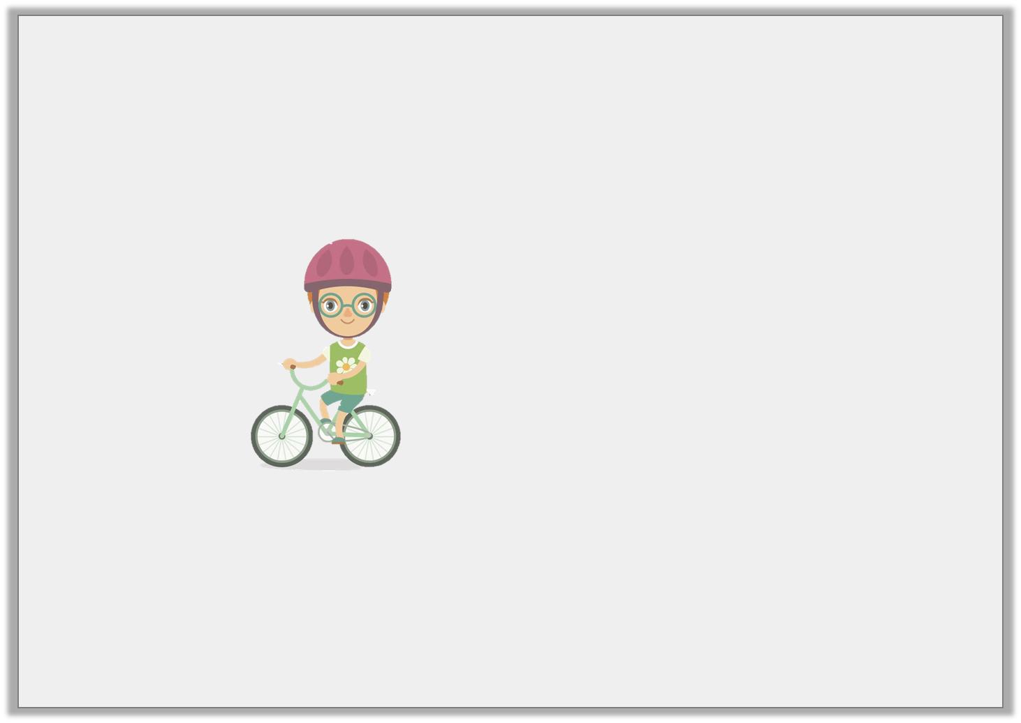
Application 1
Change the speech bubble into a sentence with direct speech.
I’m going to ride to the park.
© Classroom Secrets Limited 2019

Slide 15
Application 1
Change the speech bubble into a sentence with direct speech.
Various possible answers, for example:
Freddy said, “I’m going to ride to the park.”
I’m going to ride to the park.
© Classroom Secrets Limited 2019

Slide 16
Application 2
Complete the sentences using direct speech. Make sure they are punctuated correctly.
The boy asked….
…… shouted the police officer.
The man said….
© Classroom Secrets Limited 2019

Slide 17
Application 2
Complete the sentences using direct speech. Make sure they are punctuated correctly.
Various possible answers, for example:
The boy asked, “Can I play out?”
“STOP!” shouted the police officer.
The man said, “I’m going to buy a newspaper.”
© Classroom Secrets Limited 2019

Slide 18
Reasoning 1
Amy has written a sentence. Is it correct? Explain your answer.
Tom said “I must read my book before I go to bed.
© Classroom Secrets Limited 2019

Slide 19
Reasoning 1
Amy has written a sentence. Is it correct? Explain your answer.
Tom said “I must read my book before I go to bed.
It is not correct because…
© Classroom Secrets Limited 2019

Slide 20
Reasoning 1
Amy has written a sentence. Is it correct? Explain your answer.
Tom said, “I must read my book before I go to bed.”
It is not correct because:
the comma after the reporting clause is missing
the inverted commas to mark the end of the direct speech are missing
© Classroom Secrets Limited 2019

