Slide 1
LIFE/work balance
We have started a #LIFEworkbalance campaign and we need your help to complete our LIFE/work balance survey.
We hope to publish the results soon, so please give 15 minutes of your time to help us get a true picture of school life.
Want to be a part of this campaign? Take the survey on our website and share it with your colleagues!
© Classroom Secrets Limited 2020

Slide 2
Year 3 – Spring Block 2 – Prepositions – Using Prepositions to Express Place
About This Resource:
This PowerPoint has been designed to support your teaching of this small step. It includes a starter activity and an example of each question from the Varied Fluency and Application and Reasoning resources also provided in this pack. You can choose to work through all examples provided or a selection of them depending on the needs of your class.
National Curriculum Objectives:
English Year 3: (3G1.7) Using prepositions to express time and cause
English Year 3: (3G1.7) Express time, place and cause using prepositions [for example, before, after, during, in, because of]
Terminology for pupils:
(3G1.7) preposition
More resources from our Grammar, Punctuation and Spelling scheme of work.
Did you like this resource? Don’t forget to review it on our website.
© Classroom Secrets Limited 2019

Slide 3
Year 3 – Spring Block 2 – Prepositions – Using Prepositions to Express Place
Notes and Guidance
Once children are confident in using prepositional phrases to express time, they can move on to using them to express place, for example: My pencil is under the book.
Some common prepositions to express place include: under, over, above, on top of, behind, in the box, below.
Some children may experiment with the positioning of their prepositional phrase within a sentence.
Focused Questions
Add a prepositional phrase to express place to this sentence.
Replace this prepositional phrase to change the meaning of the sentence.
© Classroom Secrets Limited 2019

Slide 4
Year 3 – Spring Block 2 – Prepositions
Step 4: Using Prepositions to Express Place
© Classroom Secrets Limited 2019

Slide 5
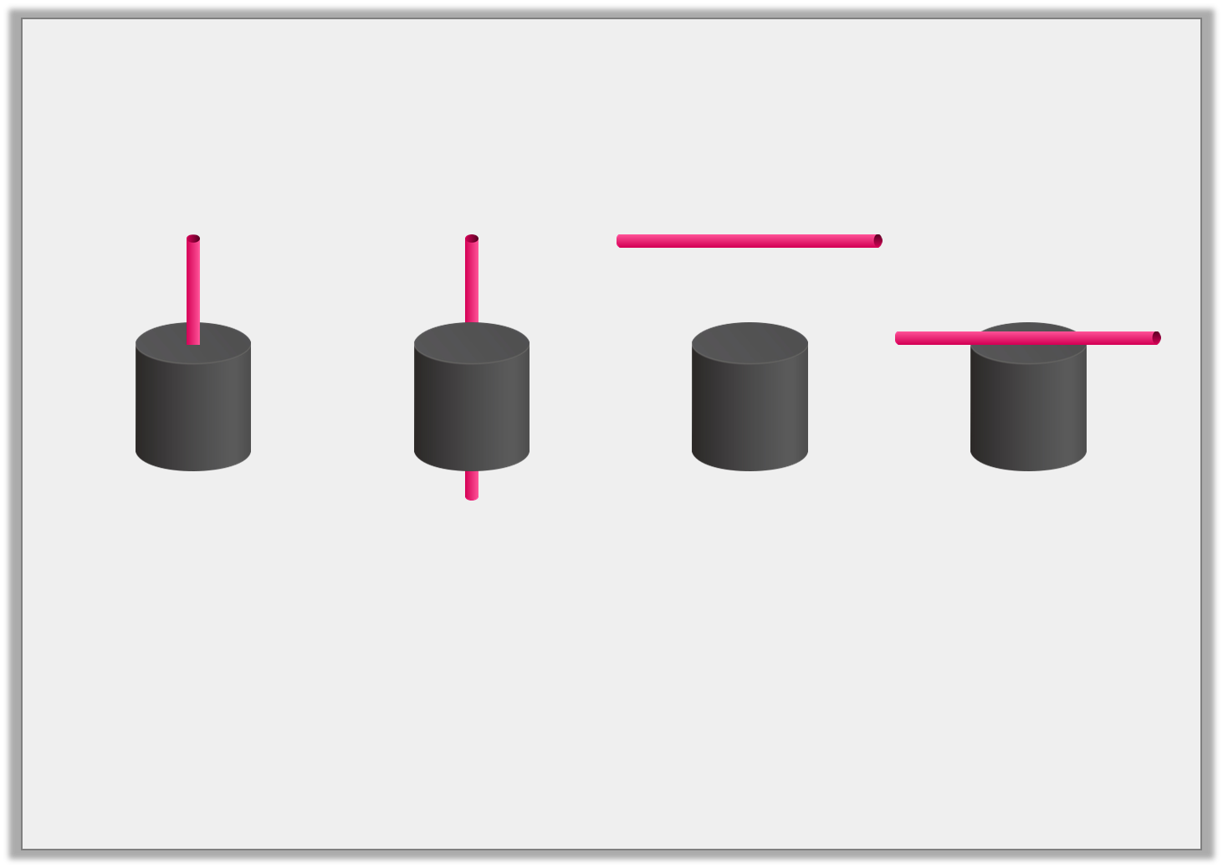
Introduction
Match each sentence to the picture it describes.
The straw is above the cylinder.
The straw is on the cylinder.
The straw is in the cylinder.
The straw is behind the cylinder.
© Classroom Secrets Limited 2019

Slide 6
Introduction
Match each sentence to the picture it describes.
The straw is above the cylinder.
The straw is on the cylinder.
The straw is in the cylinder.
The straw is behind the cylinder.
© Classroom Secrets Limited 2019

Slide 7
Varied Fluency 1
Circle the prepositions of place below.
sponge
ago
near
high
around
© Classroom Secrets Limited 2019

Slide 8
Varied Fluency 1
Circle the prepositions of place below.
sponge
ago
near
high
around
© Classroom Secrets Limited 2019

Slide 9
Varied Fluency 2
Circle the preposition expressing place in the sentence below.
The tree branches reached beyond the limits
of the palace wall.
© Classroom Secrets Limited 2019

Slide 10
Varied Fluency 2
Circle the preposition expressing place in the sentence below.
The tree branches reached beyond the limits
of the palace wall.
© Classroom Secrets Limited 2019

Slide 11
Varied Fluency 3
Underline the noun and the preposition which need to swap places for the sentence below to make sense.
The eagle whirled gracefully, high clouds the
among.
© Classroom Secrets Limited 2019

Slide 12
Varied Fluency 3
Underline the noun and the preposition which need to swap places for the sentence below to make sense.
The eagle whirled gracefully, high clouds the
among.
The eagle whirled gracefully, high among the clouds.
© Classroom Secrets Limited 2019

Slide 13
Varied Fluency 4
Use a preposition to express place in the sentence below.
I managed to swiftly hide __________ the lumps of rock.
© Classroom Secrets Limited 2019

Slide 14
Varied Fluency 4
Use a preposition to express place in the sentence below.
Various answers, for example:
I managed to swiftly hide __________ the lumps of rock.
behind
© Classroom Secrets Limited 2019

Slide 15
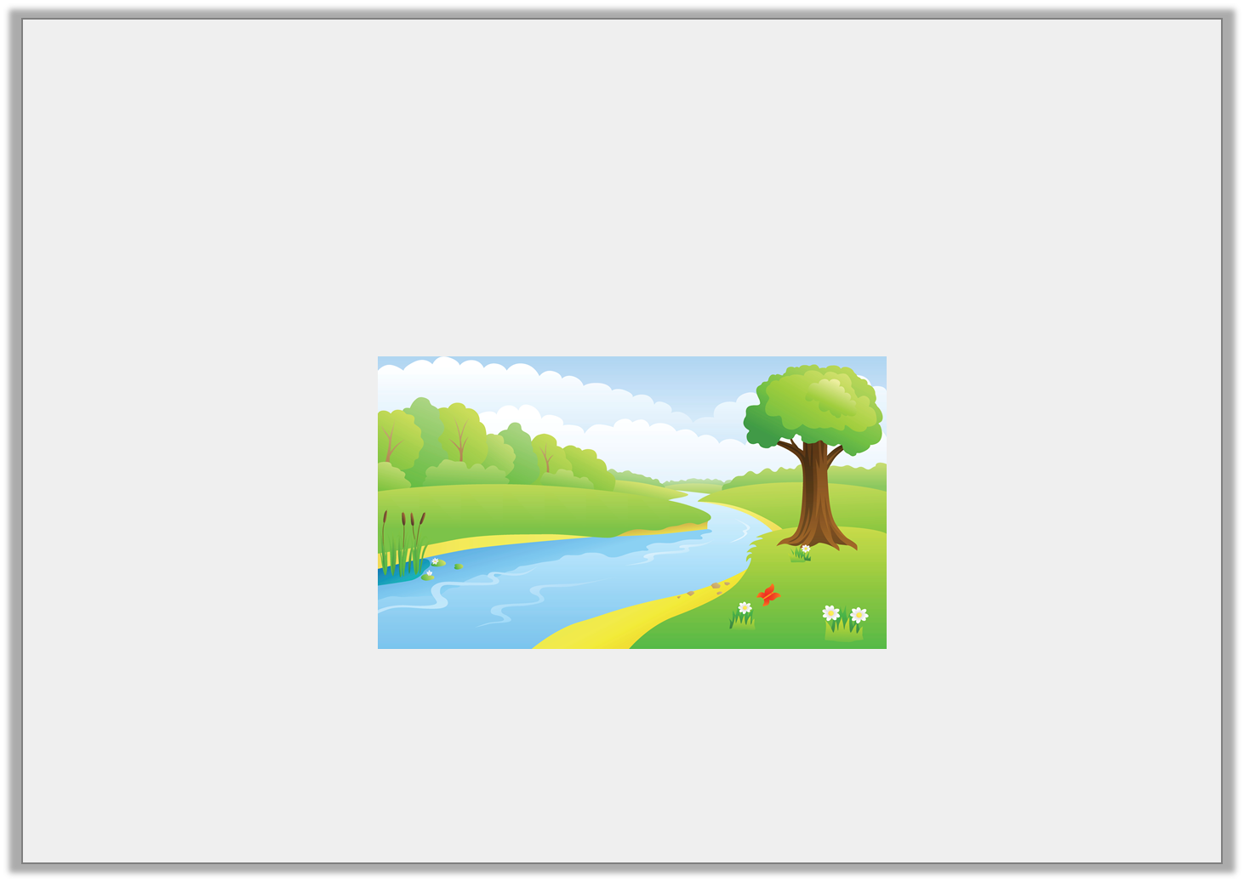
Application 1
Change the meaning of the sentence below by changing the preposition.
The winding river flowed lazily around the city.
© Classroom Secrets Limited 2019

Slide 16
Application 1
Change the meaning of the sentence below by changing the preposition.
The winding river flowed lazily around the city.
Various answers, for example: ‘through’
The dark river flowed lazily through the city.
© Classroom Secrets Limited 2019

Slide 17
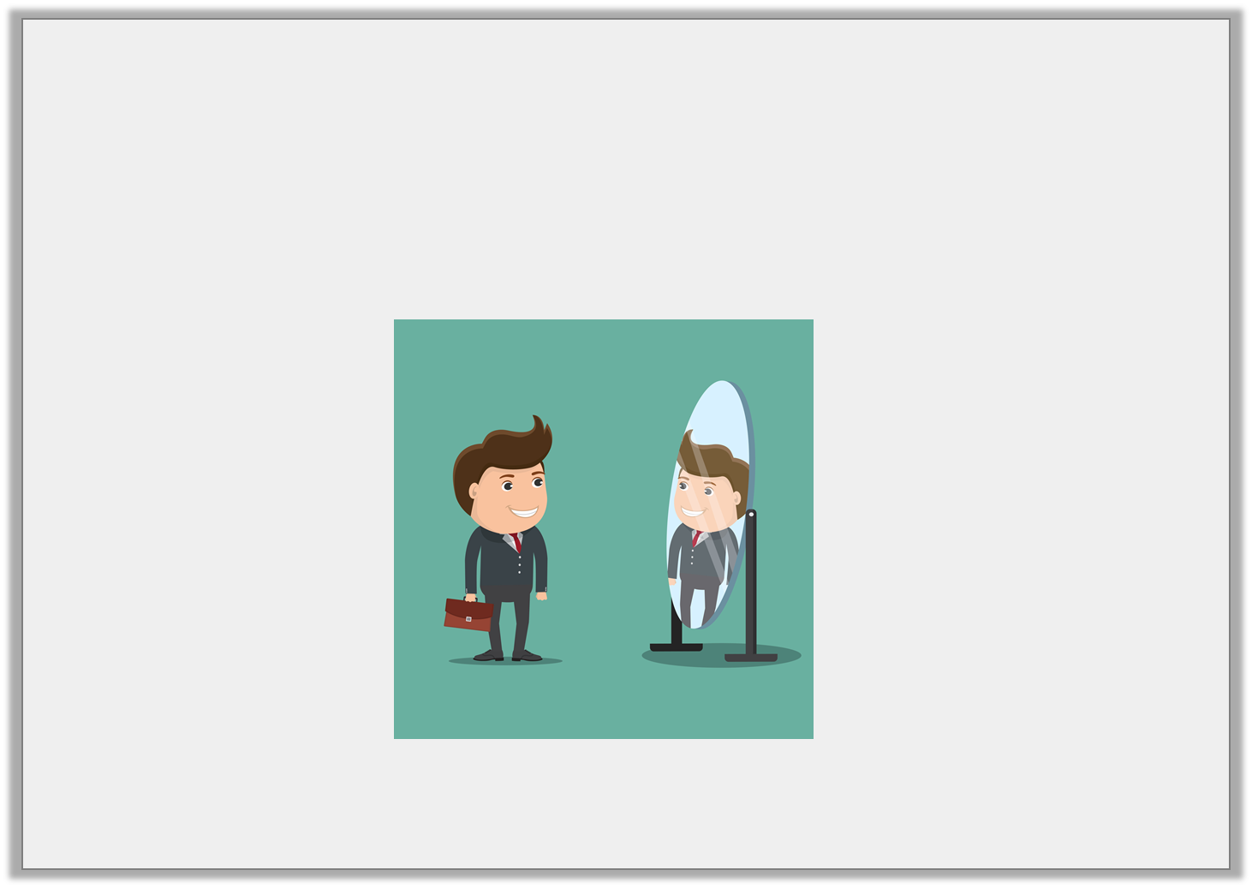
Application 2
List three prepositions which could fill the gap in the sentence below.
The businessman stared confidently ________ the mirror.
© Classroom Secrets Limited 2019

Slide 18
Application 2
List three prepositions which could fill the gap in the sentence below.
The businessman stared confidently ________ the mirror.
Various answers, for example: ‘into’, ‘at’ and ‘in’
into
© Classroom Secrets Limited 2019

Slide 19
Reasoning 1
Does the preposition make sense in the sentence below?
The ugly troll violently hurled rocks between the
tower.
© Classroom Secrets Limited 2019

Slide 20
Reasoning 1
Does the preposition make sense in the sentence below?
The ugly troll violently hurled rocks between the
tower.
No, it does not make sense because…
© Classroom Secrets Limited 2019

Slide 21
Reasoning 1
Does the preposition make sense in the sentence below?
The ugly troll violently hurled rocks between the
tower.
No, it does not make sense because there is only one tower, and using ‘between’ suggests there should be two objects for the rocks to go in the middle of. ‘Against’ could be used instead.
The ugly troll violently hurled rocks against the tower.
© Classroom Secrets Limited 2019

